Slide 1
An Introduction to PROLOG
Syntax for Predicate Calculus
Abstract Data Types (ADTs) in PROLOG
A Production System Example in PROLOG

Slide 2
Represent Facts and Rules
Facts (propositions):
    e.g. male(philip).
Rules (implications):
e.g.
  parent(X, Y) := father(X, Y).
    parent(X, Y) := mother(X, Y).
    parent(X, Y) := father(X, Y); mother(X, Y).
Questions/Queries (start point of execution):
  e.g. ?-parent(X, Y).

Slide 3
Prolog as Logic
Horn clause – a subset of first-order logic
Logic formula:
  Description – A – e.g. philip is male.
  Logic OR – A ∨ B : A; B.
  Logic AND – A ∧ B : A, B.
  Logic NOT -- ¬A : not A.
  Logic implication: A → B : B :- A.
Each expression terminates with a .
Deductive inference – Modus ponents
    A
    A → B
    --------
    B

Slide 4
A Simple Rule
English description:
If
X is male,
F is the father of X,
M is the mother of X,
F is the father of Y,
M is the mother of Y
Then
X is a brother of Y
Logic formula:
male(X) ∧
father(F, X) ∧
mother(M, X) ∧
father(F, Y) ∧
mother(M, Y)
→
brother(X, Y)
Prolog:
brother(X, Y) :-
male(X),
father(F,X),
mother(M,X),
father(F,Y),
mother(M, Y).

Slide 5
A Simple Program
A Prolog program is a sequence of facts and rules
brother(X, Y) :- male(X), parent(P, X), parent(P, Y).
parent(X, Y):- father(X, Y); mother(X, Y).
male(philip).
father(bill, philip).
father(bill,jane).
?- brother(philip, jane).

Slide 6
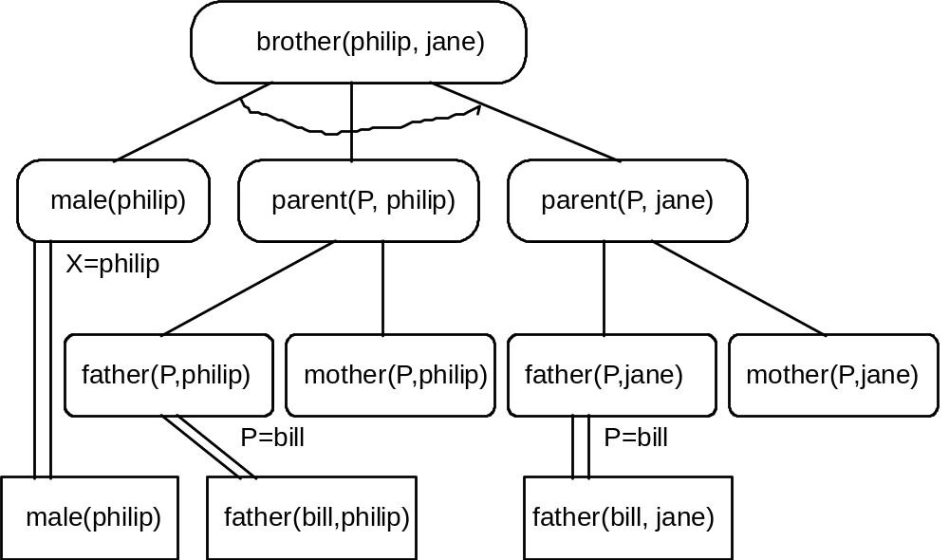
Program Trace Tree

Slide 7
Program Execution
Start from the question
Matching – match the question with facts and rules by substitution (try)
Unification – looking for unified solution (consistent solution)
Backtracking – once fails, go back to try another case
Divide-and-conquer
  divide problem into sub problems
  solve all sub problems
  integrate sub solutions to build the final solution
  Solutions to all sub problems must be consistent

Slide 8
Another Example
Facts
    mother(jane, george).
    father(john, george).
    Brother(bill, john).
Rules:
    parent(X, Y) :- mother(X, Y).
    parent(X, Y) :- father(X, Y).
    uncle(X, Y) :- parent(P, Y), brother(X, P).
Question:
    ?- uncle(X, george).

Slide 9
Program Execution Trace
uncle(X, george)
Y/george
parent(P, Y)
brother(X, P)
X/bill, P/john
P/X, Y/george
mother(X, Y)
father(X, Y)
brother(bill, john)
X/jane
X/john
mother(jane, george)
father(john, george)

Slide 10
Unification and Backtracking
First matching (dashed line):
  parent(jane, george) -- P ←jane
  brother(bill, john) -- P ← john
  which is not consistent.
Backtracking (solid line):
  parent(john, george) -- P ← john
  Brother(bill, john) -- P ← john
  which is unified
Multiple solutions
  Interactive program
  Interpreter
  Once the program outputs, the user can respond with ; to ask for more solutions
  If no more solutions, the program answers “no”

Slide 11
Prolog Environment
Add new predicates
  assert(P) – add new predicate P to database
  asserta(P) – add P to the beginning of database
  assertz(P) – add P to the end of database
Delete predicates
  retract(P) – remove P fromdatabase
Import database from a file
  consult(File)
Input/output
  read(X) – read a term from the input stream to X
  write(X) – put the term X in the output stream
  see(File) – open a file for reading (input stream)
  tell(File) – open a file for writing (output stream)

Slide 12
Prolog Program Execution Tracing
List all clauses with the predicate name
  listing(P) – regardless of the number of arguments
Monitor the program progress
trace | print every goal
exit | when a goal is satisfied
retry | if more matches
fail | enforce fail
spy | print all uses of predicates
notrace | stop the trace

Slide 13
Recursion
Base case – a set of rules for direct solution
Normal case – another set of rules for indirection solution
E.g. Fibnacci number:
fib(0) = 0, fib(1) = 1, → base case
fib(n) = fib(n-1) + fib(n-2) → normal case
Prolog program:
Facts: fib(0, 0).
fib(1, 1).
Rules: fib(X, N) :- N > 1, N1 is N - 1, N2 is N – 2,
fib(Y, N1), fib(Z, N2), X is Y + Z.
Question: ? :- fib(X, 5).
X = 5.
? :- fib(5, N).
N = 5.
? :- fib(X, 8).
X = 21.

Slide 14
Data Representation
Atom – numbers, strings, etc.
Structured data – pattern
  Format: functor(parameter-list) where parameters in the list are either atom or structured data separated with “,”
  E.g. person(name)
  student(person(name), age)
  male(bill)
  female(jane)
  Special function dot (.)
    Represents list: .(p, .pattern)
    Special .pattern: .() ➔ [], empty list
    E.g.: .(p, .(q, .(r, .(s, .()))))
    List: [p, q, r, s]
    Operations: [X|Y] ➔ pattern
  Anonyous variable: underscore (_)
  E.g. member(X, [X|_]) :- !.
member(X, [_|Y]) :- member(X, Y).

Slide 15
Lists
A sequence of elements separated by comma and enclosed by [ and ]
List elements can be other lists
Examples: [1, 2, 3, 4]
[a, george, [b, jack], 3]
Empty list: []
Non-empty lists consists of two parts
  Header – the first element
  Tail – the list containing all elements except the first
  Can be written [Header|Tail]
Example: for list [a, 1, b, 2]
  Header: a
  Tail: [1, b, 2]
Match:
  headers match and tails match
  Match [a, 1, b, 2] with [H|T]
    H = a
    T = [1, b, 2]

Slide 16
Count the number of elements
Count the number of elements in a list
  Base case: if the list is empty, then number of elements is 0
  Normal case: the number of elements in the list is the number of elements in the tail plus 1
  Rules?

Slide 17
Count the number of elements
Find the number of elements in a list
    length:-length([], 0) :- !.
    length([X|Y], N) :- length(Y, M), N is M+1.

Slide 18
Recursive Search
Depth-first search with backtracking
Ordering of facts and rules affect the problem-solving efficiency
Search a subgoal:
  Top → down: matching facts and heads of rules
Decomposition of goals:
  Left → right
Backtracking:
  Matching: Top → down
  Subgoals: right → left

Slide 19
Abstract Data Types in Prolog
ADT
  A set of operations
  No data structure specified
ADT building components
  Recursion, list, and pattern matching
  List handing and recursive processing are hidden in ADTs
Typical ADTs
  Stack, Queue, Set, Priority Queue

Slide 20
The ADT Stack
Characteristics
  LIFO (Last-in-first-out)
Operations
  Empty test
  Push an element onto the stack
  Pop the top element from the stack
  Peek to see the top element
  Member_stack to test members
  Add_list to add a list of elements to the Stack

Slide 21
The ADT Queue
Characteristics
  FIFO (First-in-first-out)
Operations
  Empty test
  Enqueue – add an element to the end
  Dequeue – remove the first element
  Peek – see the first element
  Member test
  Merge two queues

Slide 22
The ADT Priority Queue
Characteristics
  Each element is associated with a priority
  Always remove the “smallest” one
Operations
  Empty test
  Member test
  Add an element to the priority queue
  Min – find the minimum element
  Remove the minimum element
  Add a list to a priority queue

Slide 23
The ADT Set
A collection of elements
  No order
  No duplicates
Operations
  Empty test
  Member test
  Add an element to the set
  Remove an element from the set
  Union two sets
  Intersect two sets
  Difference two sets
  Subset test
  Equality test

Slide 24
A Production System in Prolog
Farmer, wolf, goat, and cabbage problem
  A farmer with his wolf, goat, and cabbage come to the edge of a river they wish to cross. There is a boat at the river’s edge, but, of course, only the farmer can row. The boat also can carry only two things, including the rower, at a time. If the wolf is ever left alone with the goat, the wolf will eat the goat; similarly, if the goat is left alone with the cabbage, the goat will eat the cabbage. Devise a sequence of crossings of the river so that all four characters arrive safely on the other side of the river.
Representation
  state(F, W, G, C) describes the location of Farmer, Wolf, Goat, and Cabbage
  Possible locations are e for east bank, w for west bank
  Initial state is state(w, w, w, w)
  Goal state is state(e, e, e, e)
  Predicates opp(X, Y) indicates that X and y are opposite sides of the river
  Facts:
  opp(e, w).
  opp(w, e).

Slide 25
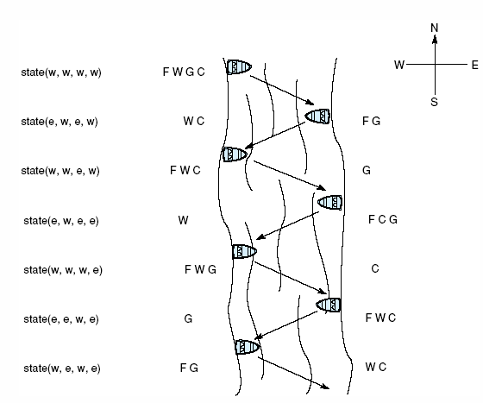
Sample crossings for the farmer, wolf, goat, and cabbage problem.

Slide 26
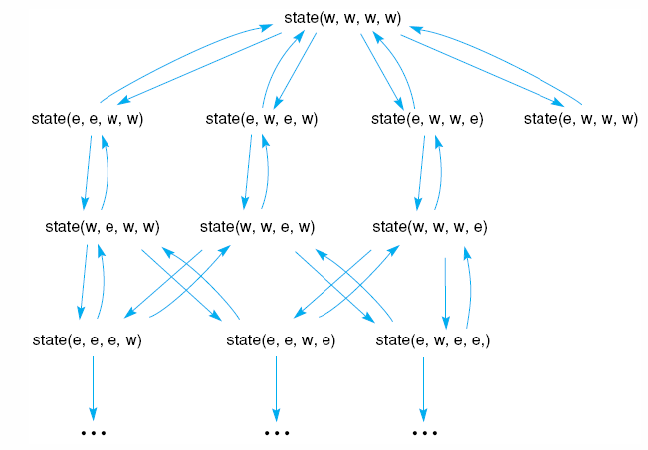
Portion of the state space graph of the farmer, wolf, goat, and cabbage problem, including unsafe states.

Slide 27
Production Rules in Prolog
Unsafe states
  unsafe(state(X, Y, Y, C)) :- opp(X, Y).
  unsafe(state(X, W, Y, Y)) :- opp(X, Y).
Move rules
  move(state(X, X, G, C), state(Y, Y, G, C))) :- opp(X, Y),
  not(unsafe(state(Y, Y, G, C))),
  writelist([‘farms takes wolf’, Y, Y, G, C]).
  move(state(X, W, X, C), state(Y, W, Y, C)) :- opp(X, Y),
  not(unsafe(state(Y, W, Y, C))),
  writelist([‘farmers takes goat’, Y, W, Y,C]).
  move(state(X, W, G, X), state(Y, W, G, Y)) :- opp(X, Y),
  not(unsafe(state(Y, W, G, Y))),
  writelist(‘farmer takes cabbage’, Y, W, G, Y]).
  move(state(X, W, G, C), state(Y, W, G, C)) :-opp(X, Y),
  not(unsafe(state(Y, W, G, C))),
  writelist([‘farmer takes self’, Y, W, G, C]).
  move(state(F, W, G, C), state(F, W, G, C)) :-
  writelist([‘Backtrack from ‘, F, W, G, C]), fail.

Slide 28
Production Rules in Prolog
Path rules
  path(Goal, Goal, Stack) :-
  write(‘Solution Path Is: ‘), nl, reverse_print_stack(Stack).
  path(State, Goal, Stack) :-
  move(State, Next), not(member_stack(Next, Stack)),
  stack(Next, Stack, NewStack),
  path(Next, Goal, NewStack), !.
Start rule
  go(Start, Goal) :-
  empty_stack(EmptyStack),
  stack(Start, EmptyStack, Stack),
  path(Start, Goal, Stack).
Question
  ?- go(state(w, w, w, w), state(e, e, e, e)

